Slide 1
PROJECT PRESENTATION
Android Application
On
PERFECT GIFT
Presented By :
Shreyash Mehta
Shubham Garg
B.Tech (CSE)
8TH SEM

Slide 2
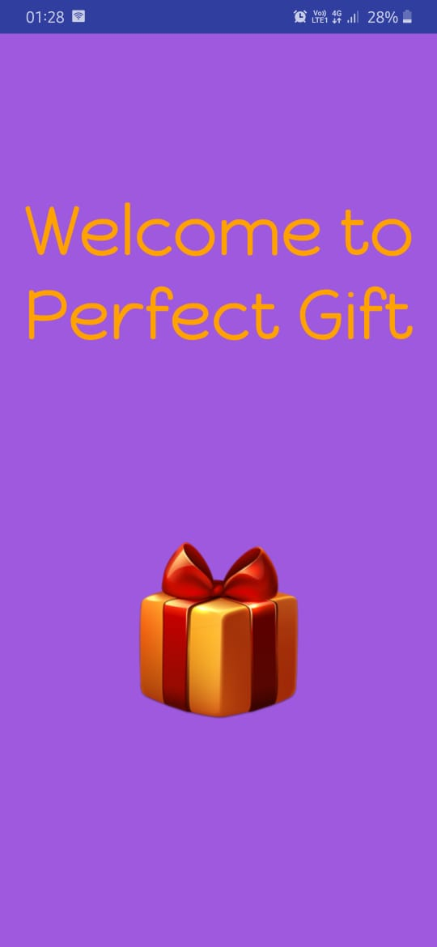
Introduction
Perfect Gift is basically designed for Mobile based Application. The main purpose of this project is to save the time of the users by providing all the information regarding buying the gift at one platform.

Slide 3
Review
This app was designed and implemented using the Android Studio.
Android is a software package and linux based operating system for mobile devices such as tablet computers and smartphones.
Java language is mainly used to write the android code even though other languages can be used.
The goal of android project is to create a successful real-world product that improves the mobile experience for end users.

Slide 4
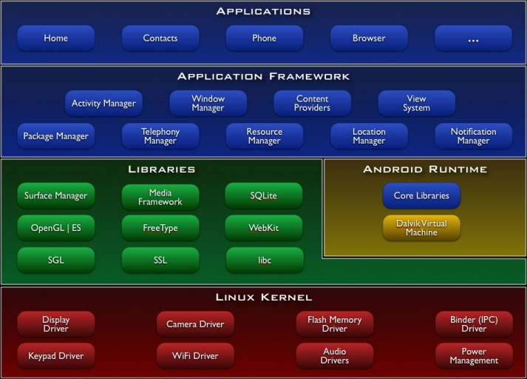
Android Architecture

Slide 5
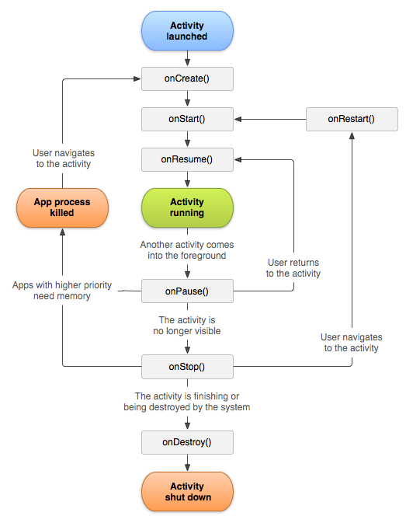
Android Life Cycle

Slide 6

Objective
Finding the perfect present for your friends and family.

Slide 7

This App
there’s something for everyone

Slide 8
Methodology
Perfect Gift has been implemented using Android Studio. This project gives the best possible suggestion of the gift according to the user's needs. Users need to register themselves and then answer four simple questions. After this users can see the suggested Gifts according to their requirements.

Slide 9
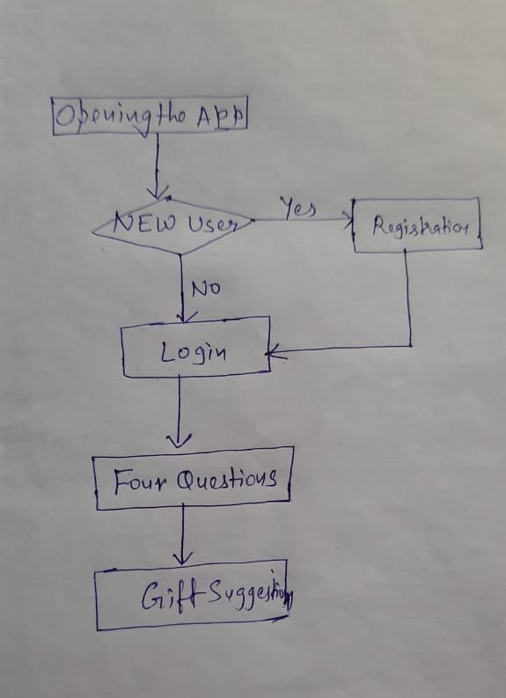

Slide 10
Outcome of the Project
After answering the four questions asked about the gender, age group, budget, and the personality of the person.
The app gives the outcome in the form of suggestion of gift that can be given to the person.

Slide 11
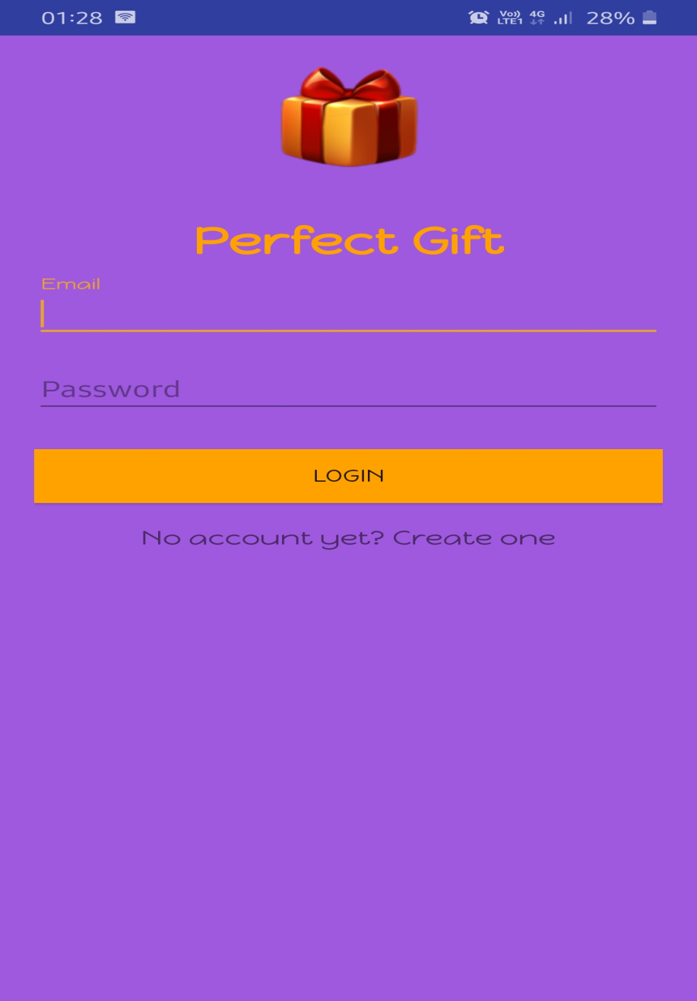
Login Screen
The user needs to login. If he is already registered that he can directly login.
Else he needs to get registered by clicking on Create one.

Slide 12
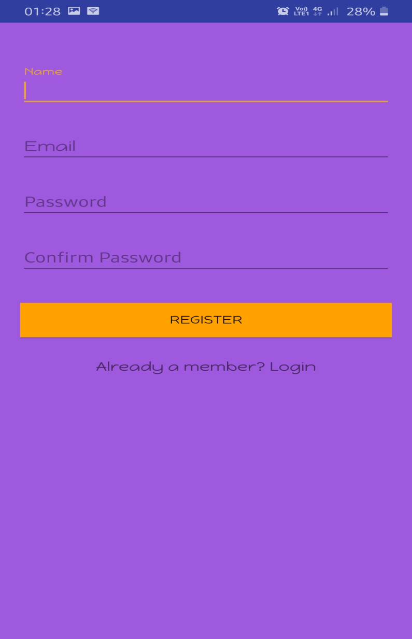
Registration Screen
First-time users need to get registered. Name, Email, and Password are required information.
After that user gets registered and can login with email and password.

Slide 13
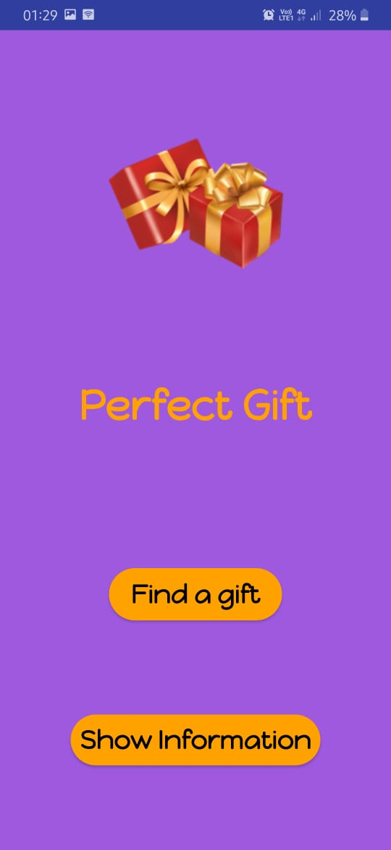
Main Screen

Slide 14
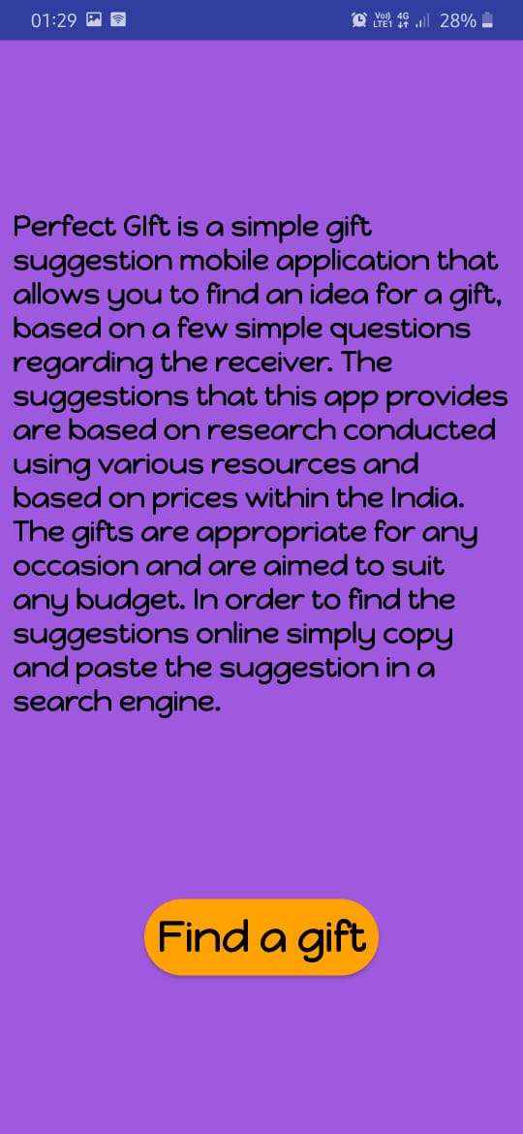
When you click on Show Information

Slide 15
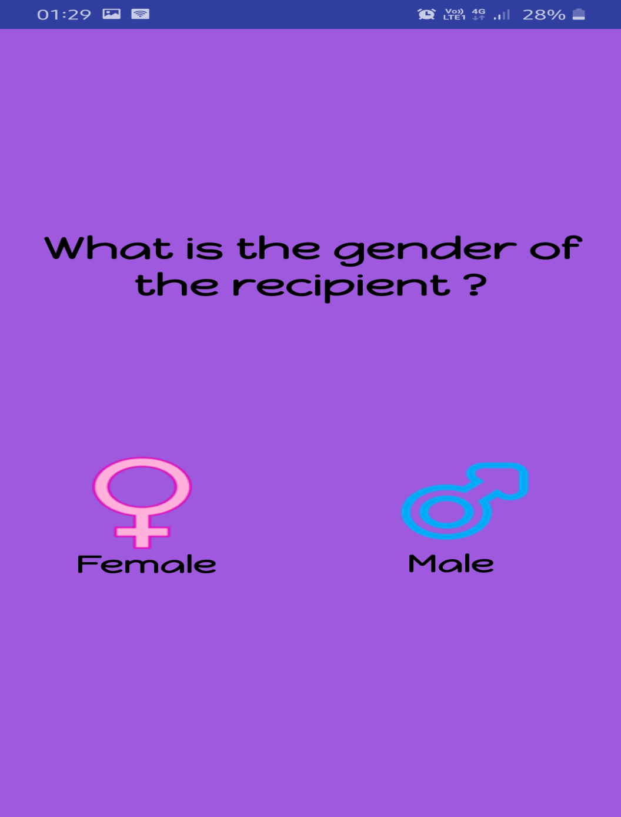
On clicking Find Gift, you come to the questionnaire. Here comes the First Question.

Slide 16
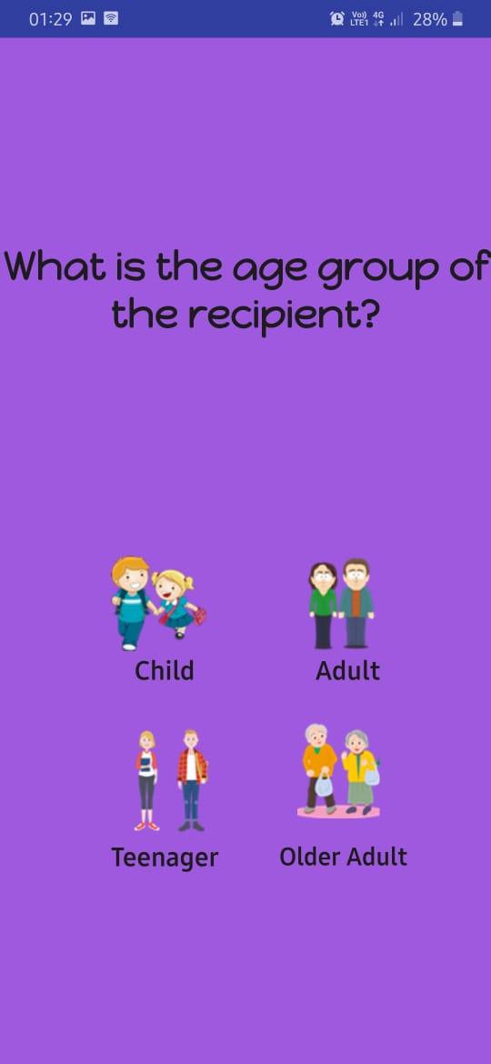
Second Question after choosing Gender.

Slide 17
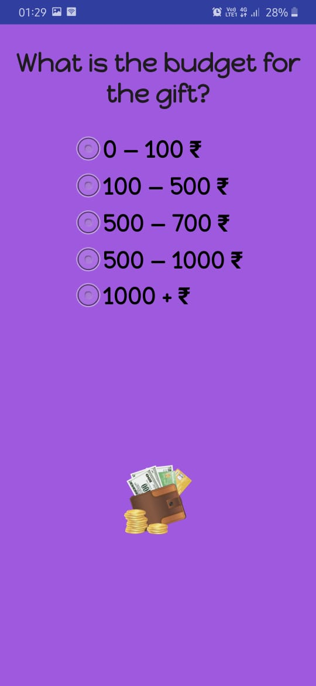
Third Question asks about your Budget.

Slide 18
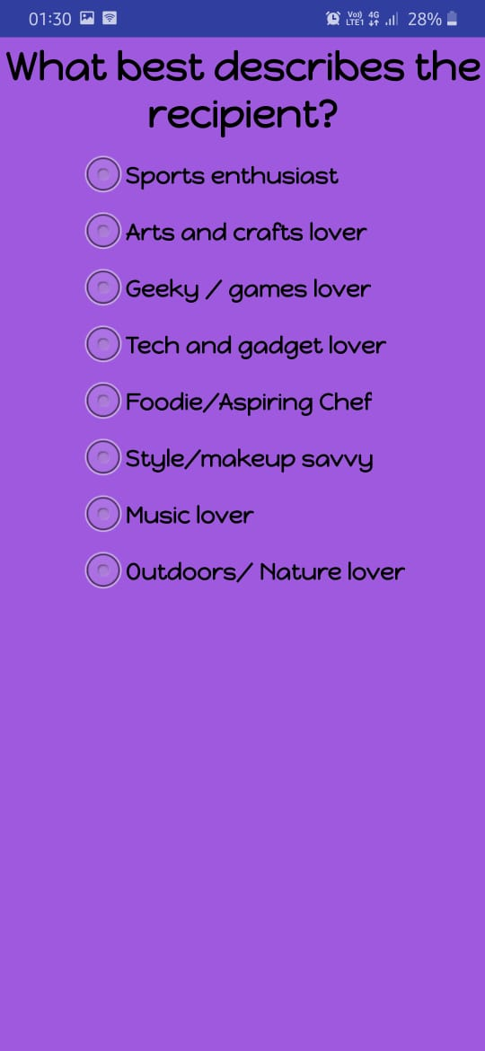
Next Question asks how well you know the person.

Slide 19
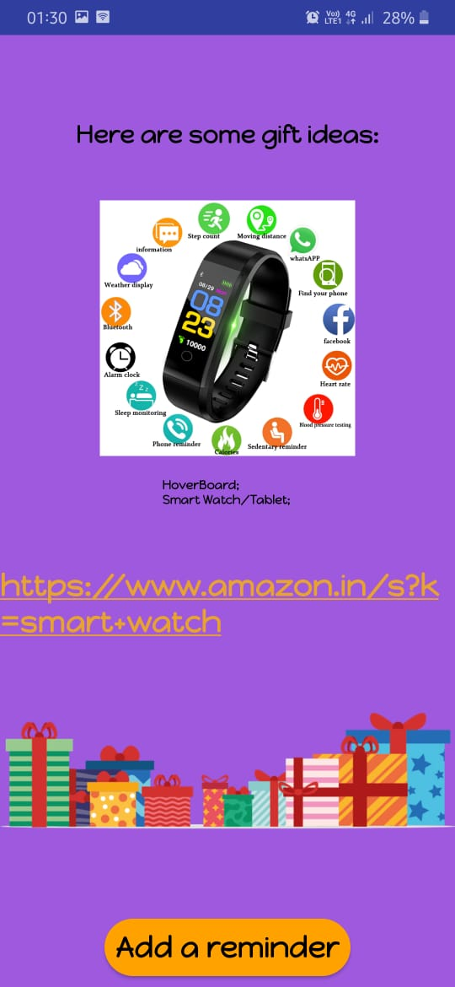
Here what you have been waiting for the gift suggestion and click on the link to get the gift.

Slide 20
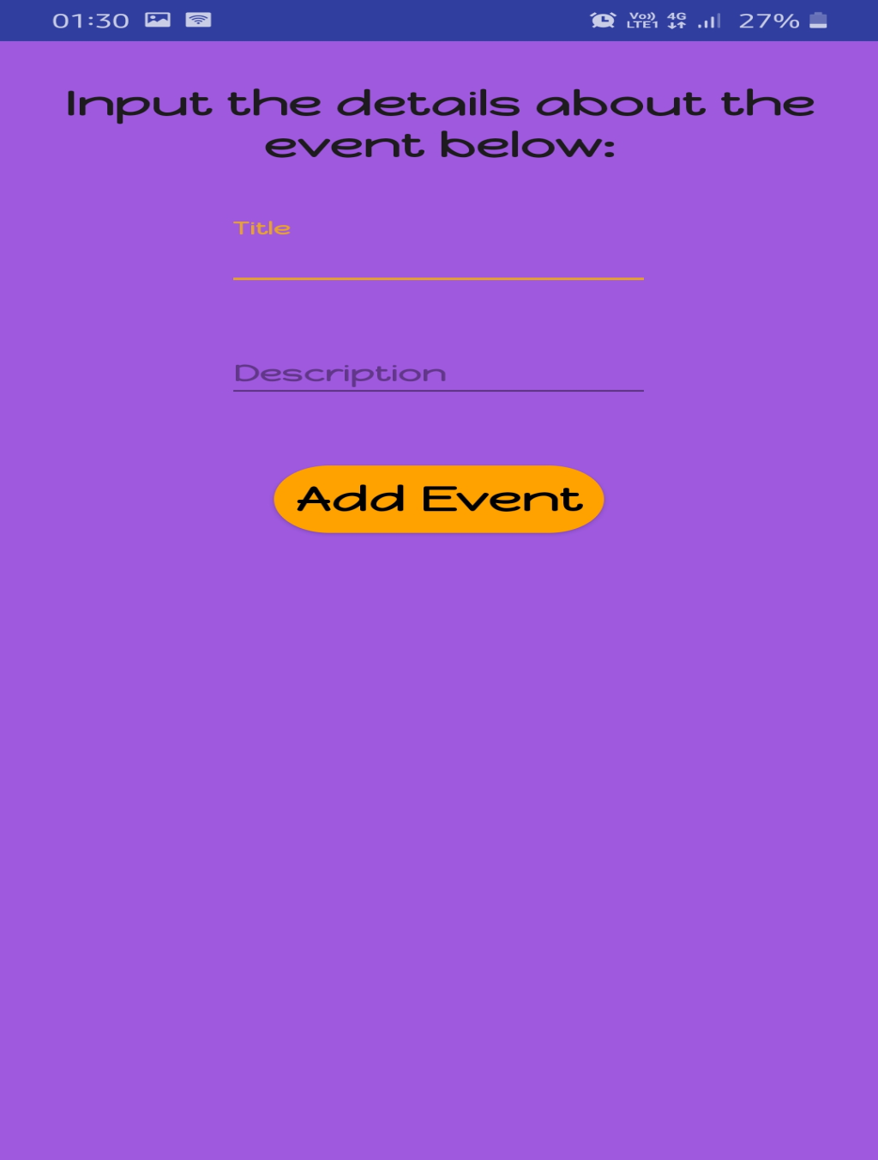
You can also Add Events if you want.

Slide 21
Results and Discussion
The app is successfully able to suggest a gift to user.
Picking out the perfect gift requires plenty of energy, thoughtfulness, and yes, cash. But now we introduce you to the gift suggestion giving app, which help you find the best gift.
This app can be a great online arena, where users can find their perfect gift for their loved ones without wasting their time.

Slide 22


